Slide 1
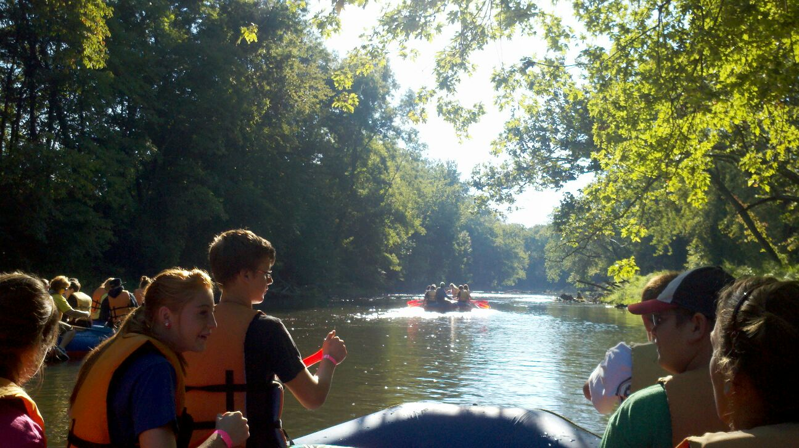
River Raft Program Checklist A complete checklist of what is needed to put on your own river rafting program for high school students. Andrea Baker, Falon French, Sarah Wolf

Slide 2
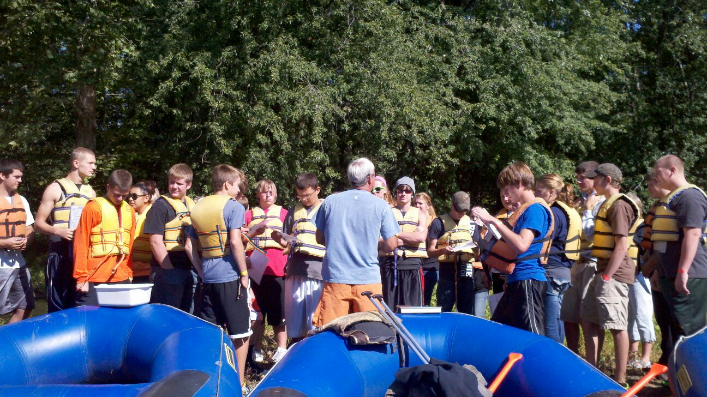
Equipment
Equipment needed for a rafting trip planned to accommodate 100 students and 10 adults.
Total Cost for all Equipment $38,370.35

Slide 3
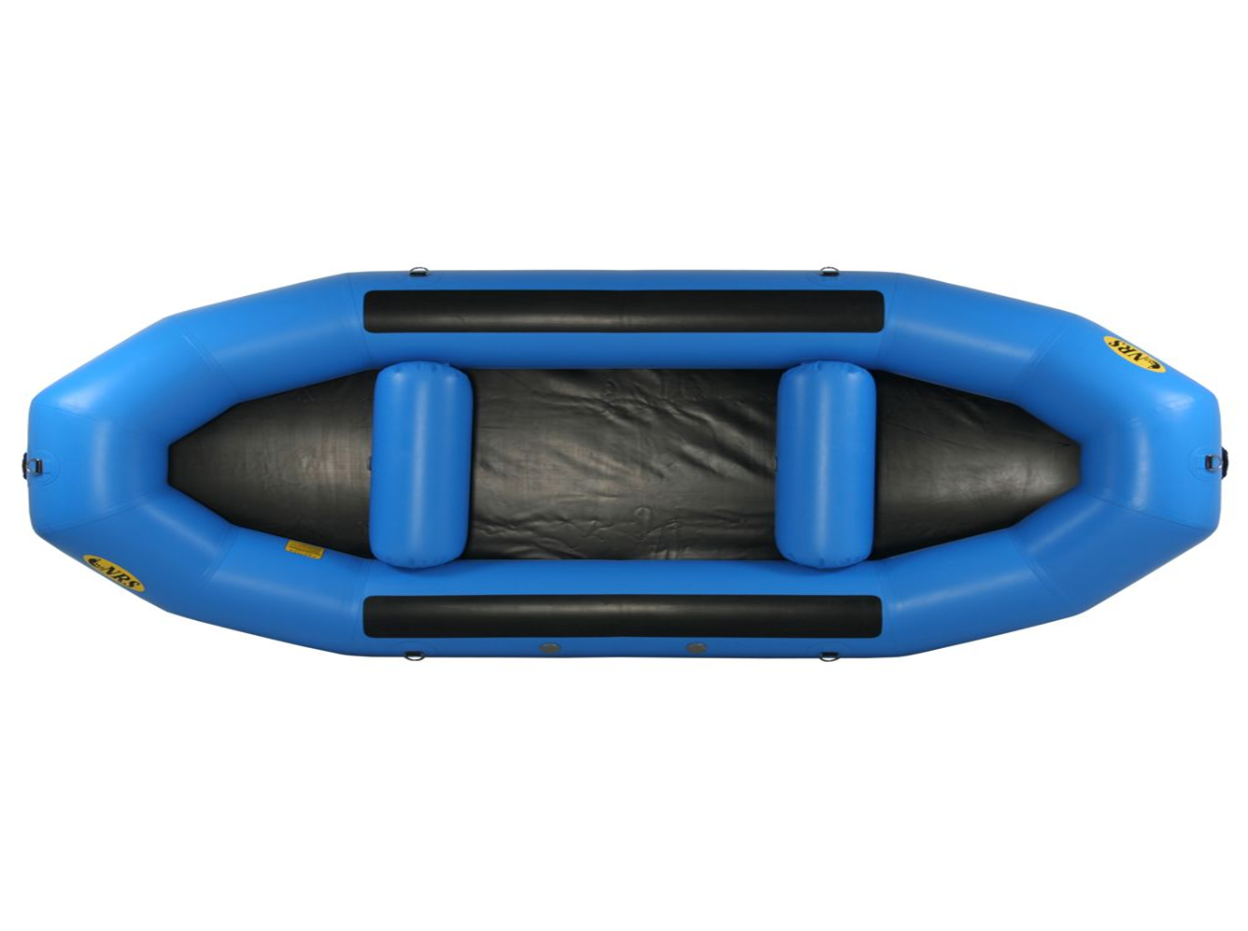
Equipment
13 of these 13’ Otter Livery 130 rafts will be needed.
Each raft can comfortably hold 8 paddlers.
Cost: $2,575.00 each

Slide 4
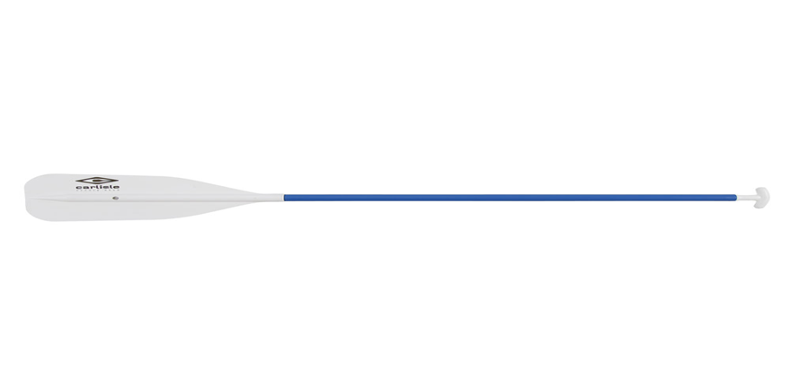
Equipment
13 of these 60” standard paddles will be needed.
One for each of the rafts.
Cost: $29.95 each

Slide 5
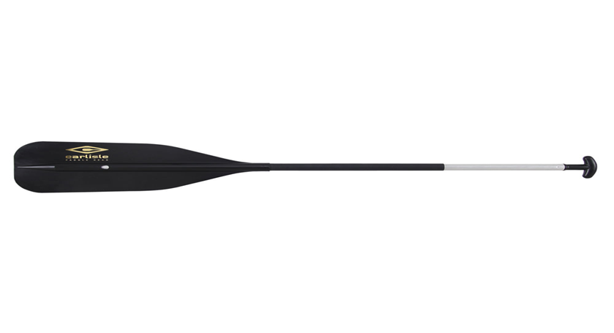
Equipment
100 of these lightweight paddles will be needed.
One for each of the students.
Cost: $19.95 each

Slide 6
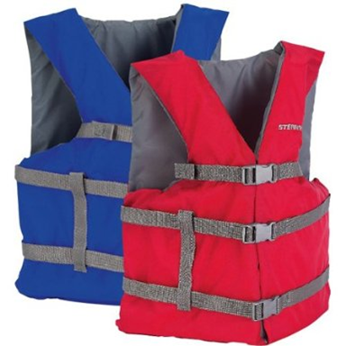
Equipment
110 of these life vest will be needed.
One for each student and for each adult.
Cost: $19.20 each

Slide 7
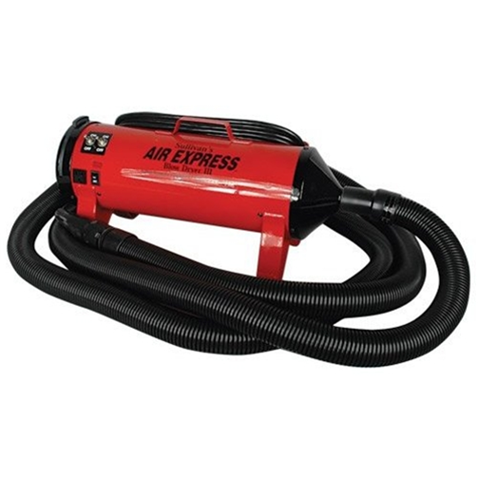
Equipment
One of these blowers will be needed to inflate the rafts.
Cost: $399.00

Slide 8
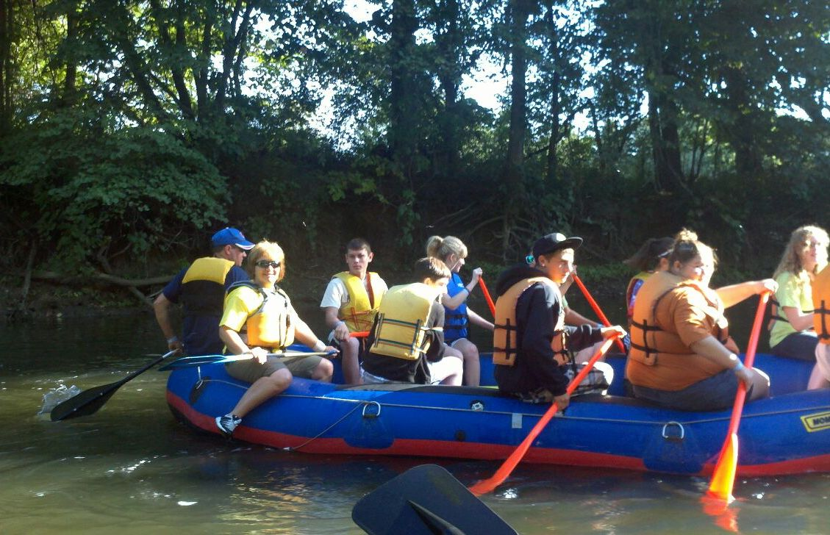
Event Logistics:
Liability waiver

Slide 9
Event Logistics:
Liability waiver
Insurance

Slide 10
Event Logistics:
Liability waiver
Insurance
Emergency Plan

Slide 11
Event Logistics:
Liability waiver
Insurance
Emergency Plan
First Aid

Slide 12
Event Planning Checklist:
One Month Prior to the Event:
Confirm rough attendance anticipated. Groups to contact regarding a rafting excursion include: high school classes; science or environmental clubs and organizations at the local high schools; boy and girl scout troops, youth groups at local churches, etc.
Identify a target event date, and line up a back-up date in case of inclement weather.
Contact speakers and plan educational sessions.

Slide 13
Event Planning Checklist:
Two Weeks Prior to the Event:
Confirm final attendance.
Basic equipment check. Ensure that rafts do not have any holes or leaks, paddles and life jackets are in good working order and have not been lost, and equipment is ready for the trip. Allow sufficient time to order more equipment
Finalize speakers and educational sessions.
Plan an advance rafting trip. Ensure that river conditions are safe, and any potentially hazardous areas and log jams are identified and a plan is in place to remove blockage or navigate around it.

Slide 14
Event Planning Checklist:
One Week Prior to the Event:
Check weather reports for inclement weather. If heavy rains, storms, or extreme flooding are anticipated, contact student chaperones and make plans for an alternate date.
Plan a second advance rafting trip two or three days prior to the anticipated event. Include stops for educational sessions, and conduct a “dry run” to ensure that the trip leaders are familiar with the route and planned stops.
Final equipment check.
Print any required educational materials.

Slide 15
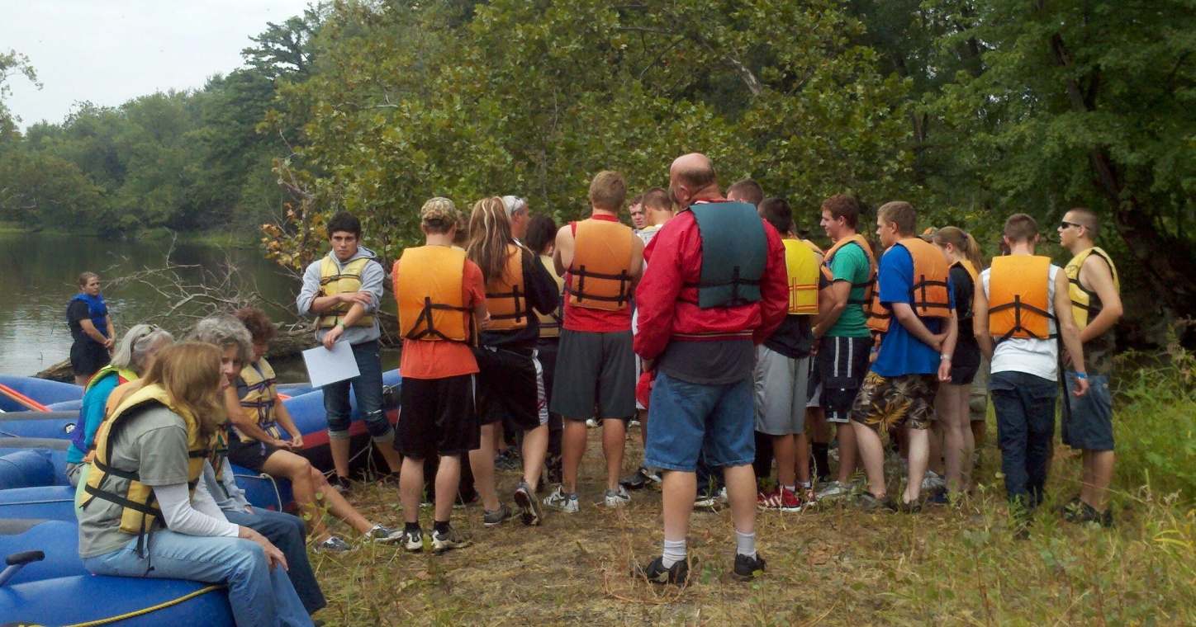
Event Planning Checklist:
After the Event:
Clean equipment, check for damage.
Make sure all equipment is stored properly until it is needed again.

Slide 16
Educational standards that can be met with this program:
Indiana Academic Standards
The following Indiana Academic Standards are taken into consideration in the construction of the River Expedition & Academic Competition and are covered in part or fully.
Biology : B.1.15, B.1.16, B.1.17, B.1.18, B.1.37, B.1.38, B.1.39, B.1.40, B.1.41, B.1.42, B.1.45, B.1.46, B.1.47
Chemistry : C.1.3, C.1.8
Environmental Sciences : ENV. 1.1, ENV.1.2, ENV.1.3, ENV.1.4, ENV.1.10, ENV.1.13, ENV.1.14, ENV.1.21, ENV.1.23, ENV.1.24, ENV.1.27, ENV.1.28, ENV.1.29, ENV.1.30, ENV.1.35
Natural Resource Management : NRM.B.2, NRM.B.3, NRM.B.4, NRM.C.1, NRM.C.2, NRM.C.3, NRM.C.4, NRM.D.1, NRM.D.2, NRM.D.10, NRM.H.2, NRM.I.1, NRM.J.1, NRM.J.2, NRM.L.1, NRM.L.2, NRM.L.4, NRM.L.6
Earth and Space Science : ES.1.20, ES.1.25, ES.1.26

Slide 17
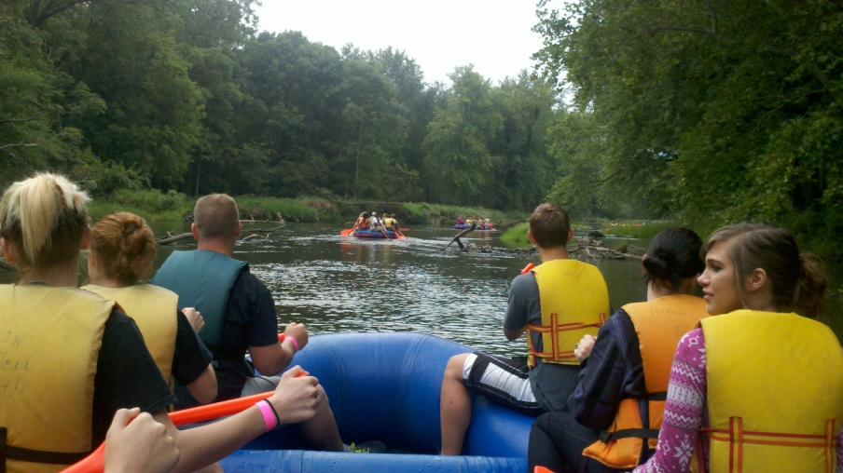
Education Stops and Talks
Overview of river and history
While paddling or on land, an over- view of the river will give the students a better overall picture of the river. Explain to the students how humans impact the river (past and present).
Possible presenters: Indiana Department of Natural Resources, Division of State Parks and Reservoirs

Slide 18
Education Stops and Talks
Watershed
A good way to start the raft trip is a presentation about the watershed. This can be done with a watershed demonstration using an Enviroscape (www.enviroscapes.com) or a plastic table cloth set-up. It is important to emphasize that no matter where you are in the watershed, what you do impacts the watershed.
Possible presenters: local Soil and Water Conservation District, Indiana State Department of Agriculture.
Water quality testing with chemical tests and inventory of macro invertebrates. This can be done at one stop, split into two stops, or done by the raft guides on the river.
Possible presenters: Hoosier Riverwatch instructors

Slide 19
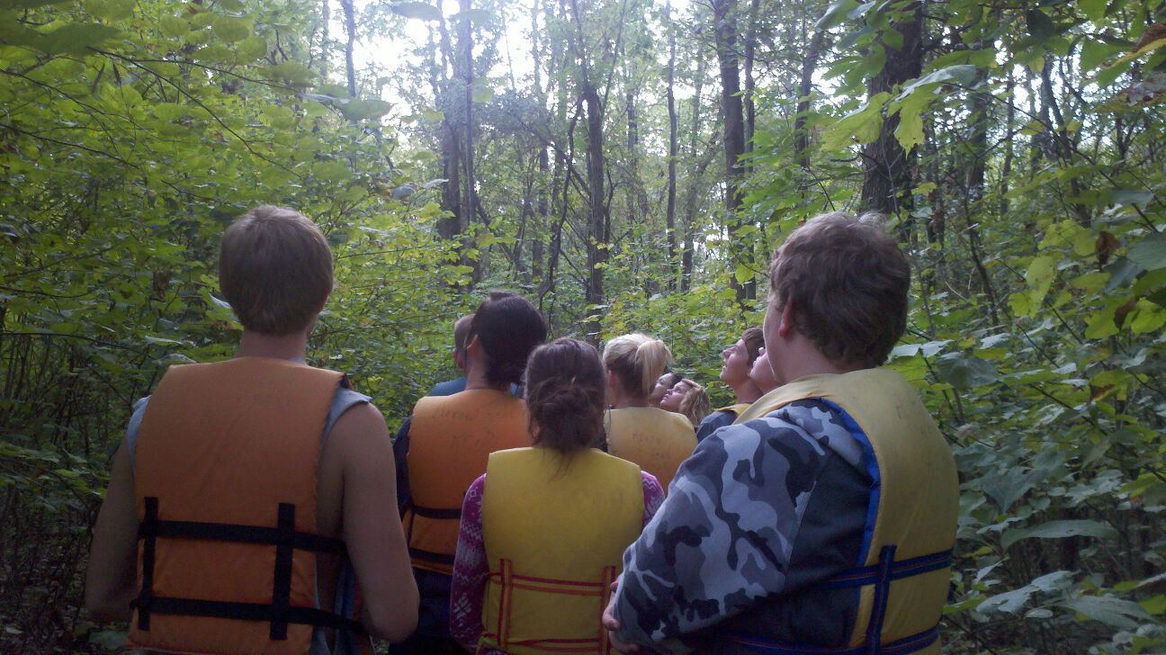
Education Stops and Talks
Plants
Many topics can be covered at the plants stop. If you have forest along your river, the talk could center on forestry and the impact of invasive plant species. If you have prairie areas along your river, the talk could center on native prairie plants.
Possible presenters: Indiana Depart- ment of Natural Resources, Division of Forestry or Division of State Parks and Reservoirs

Slide 20
Education Stops and Talks
Best Management Practices and Land Use
Be sure to highlight any best management practices that can be seen from the river or show areas that would benefit from these practices.
Possible presenters: local Soil and Water Conservation District, Natural Resources Conservation Service, and/or Indiana State Department of Agriculture

Slide 21
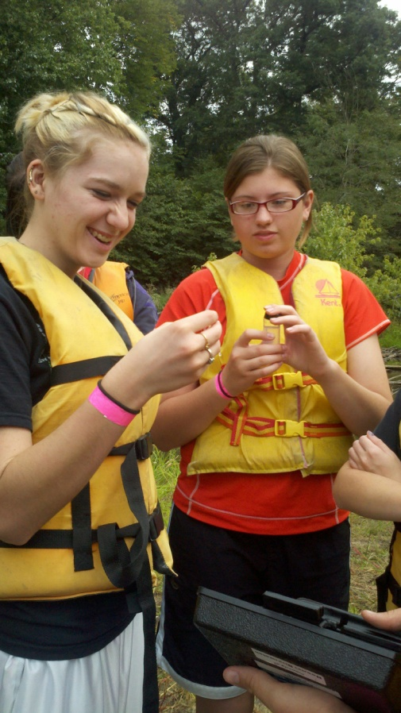
Education Stops and Talks
Best Management Practices and Land Use
Be sure to highlight any best management practices that can be seen from the river or show areas that would benefit from these practices.
Possible presenters: local Soil and Water Conserv- ation District, Natural Resources Conservation Service, and/or Indiana State Department of Agriculture

Slide 22
Education Stops and Talks
Point and Non-Point Source Pollution
This would be a good talk to do after the water quality testing stop. You could discuss pipes emptying into the river. You could also discuss how it is difficult to determine which field the fertilizer that you measured in river came from.
Possible presenters: your local Soil and Water Conservation District, Natural Resources Conservation Service, and/or Indiana State Department of Agriculture

Slide 23
Education Stops and Talks
Soils
Our soils are important for many reasons; they grow our food, they filter our water, and we live on them.
Possible presenters: your local Soil and Water Conservation District, Natural Resources Conservation Service, and/or Indiana State Department of Agriculture

Slide 24
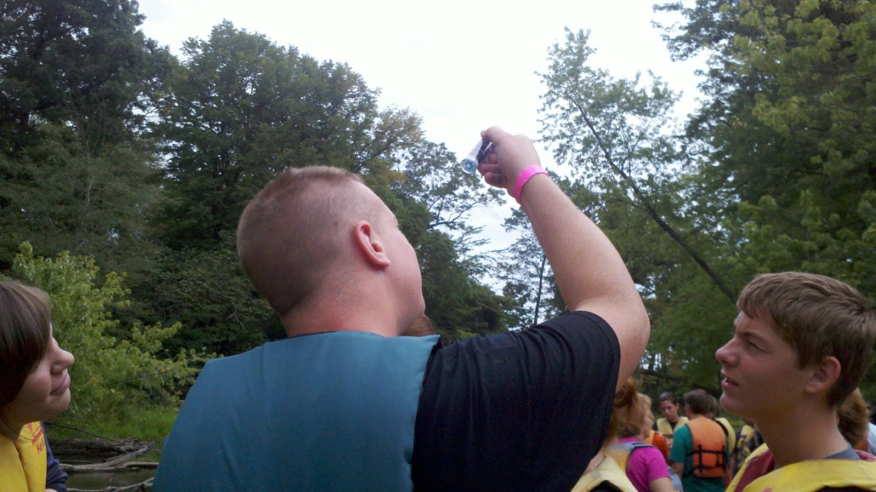
Education Stops and Talks
Threatened and endangered species
Tailor this talk to threatened and endangered species that previously or currently can be found in the area, such as mussels or river otters.
Possible presenters: Indiana Department of Natural Resou- rces, Division of State Parks and Reservoirs or Division of Fish and Wildlife

